Slide 1
Hierarchical Clustering

Slide 2
Outline
What is Hierarchical Clustering?
Dendrogram
Types of Hierarchical Clustering
How Hierarchical Clustering works
Distance measures

Slide 3
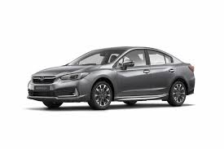
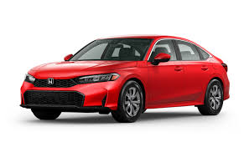
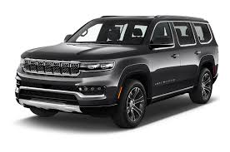
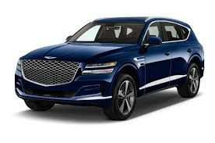
Let us consider that we have a set of cars and we have to group similar one’s together

Slide 4
From our example, we can group them together based on their type.
Sedans are type of cars which are generally smaller and lighter compared to SUVs which are larger and heavier.
Let us create two clusters, Sedan and SUV.

Slide 5
Finally, because they are all cars, we group everything into one Car cluster

Slide 6
Finally, because they are all cars, we group everything into one Car cluster
We terminate when we are left with only one cluster

Slide 7
Hierarchical clustering
Hierarchical Clustering is separating data into different groups based on some measure of similarity

Slide 8
Hierarchical clustering
Unlike k-means, hierarchical clustering doesn’t require the user to specify the number of clusters beforehand.
Instead, it returns an output (typically as a dendrogram)
The user will then decide the appropriate number of clusters (either manually or algorithmically).

Slide 9
Dendrogram
A tree-like diagram that shows the hierarchical relationship between objects or groups of objects.

Slide 10
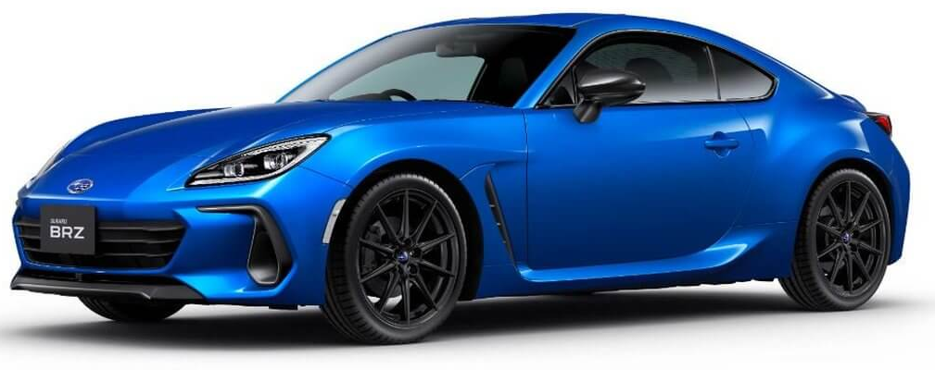
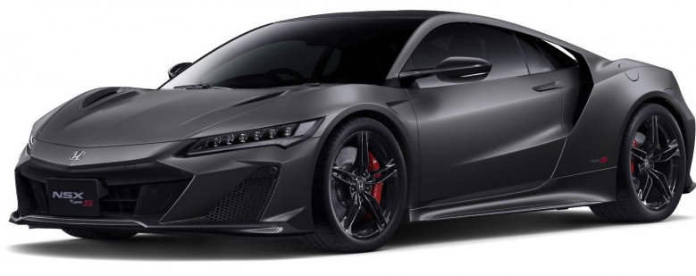
Data
Dendrogram

Slide 11
Data
Dendrogram
We now have 1 cluster, the Sedan cluster

Slide 12
Data
Dendrogram
We now have 2 clusters, the Sedan and Sports car cluster

Slide 13
Data
Dendrogram
We now have 3 clusters, the Sedan and Sports car and SUV cluster

Slide 14
Data
Dendrogram
The height of the dendrogram indicates the order in which the clusters were joined.
We now have 2 clusters, the rear wheel drive cluster and SUV cluster

Slide 15
Data
Dendrogram
We now have 1 cluster, the Car cluster

Slide 16
Data
Dendrogram
Dendrograms are often used to show the arrangement of clusters created by hierarchical clustering

Slide 17
Hierarchical clustering
If done manually, the user may cut the dendrogram where the merged clusters are too far apart (represented by a long lines in the dendrogram). Alternatively, the user can just return a specific number of clusters (similar to k-means).

Slide 18
Types of Hierarchical Clustering
Agglomerative Clustering is known as bottom-up approach.

Slide 19
Types of Hierarchical Clustering
Divisive Clustering is known as top-down approach.

Slide 20
How Hierarchical clustering works?
P5
P6
P4
P3
P2
P1
Let us consider we have plotted a few data points of our dataset on a two-dimensional plane

Slide 21
How Hierarchical clustering works?
P5
P6
P4
P3
P2
P1
In Hierarchical Clustering, each data point is a cluster of its own.

Slide 22
How Hierarchical clustering works?
P5
P6
P4
P3
P2
P1
The first step is to find the least distance between two data points to form a new cluster

Slide 23
How Hierarchical clustering works?
P5
P6
P4
P3
P2
P1
There are different distance measures to find the least distance between two data points such as Euclidean, Manhattan and Cosine distance. We will talk about them later

Slide 24
How Hierarchical clustering works?
P5
P6
P4
P3
P2
P1
Data points that have very similar features will have a small distance between them.

Slide 25
Dendrogram
P5
P6
P4
P3
P2
P1
P1
P2
P3
P4
P5
P6
As always, a dendrogram will help us track each cluster we have formed from our dataset.

Slide 26
Dendrogram
P5
P6
P4
P3
P2
P1
P1
P2
P3
P4
P5
P6
After calculating the least distance, the two nearest data points are merged together to form a new cluster

Slide 27
Dendrogram
P5
P6
P4
P3
P2
P1
P1
P2
P3
P4
P5
P6
In this example, the closest data point from P1 is P2 . We group P1 and P2 to form a new cluster.

Slide 28
Dendrogram
P5
P6
P4
P3
P2
P1
P1
P2
P3
P4
P5
P6
We do this to all to all data points and group them together to form their own cluster.

Slide 29
Dendrogram
P5
P6
P4
P3
P2
P1
P1
P2
P3
P4
P5
P6
Again, we calculate the least distance again between each cluster by using the distance measure we used earlier.

Slide 30
Dendrogram
P5
P6
P4
P3
P2
P1
P1
P2
P3
P4
P5
P6
We then group the newly created clusters that are nearest to each other.

Slide 31
Dendrogram
P5
P6
P4
P3
P2
P1
P1
P2
P3
P4
P5
P6
We calculate the distance again and merge the two remaining clusters

Slide 32
Dendrogram
P5
P6
P4
P3
P2
P1
P1
P2
P3
P4
P5
P6
And we terminate until we are left with one cluster

Slide 33
How do we measure the distance between data points?
P5
P6
P4
P3
P2
P1

Slide 34
Distance measure
The distance measure will determine the similarity between two data points and it will influence the shape of the clusters.
Squared Euclidean Distance
Cosine
Distance
Euclidean Distance
Manhattan Distance

Slide 35
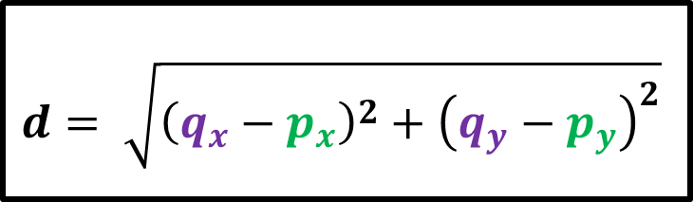



Euclidean Distance
The Euclidean distance is the ordinary straight line
It is the distance between two points in euclidean space
$$q (x,y)$$
$$d= \sqrt{{\left(q_{x}−p_{x}\right)}^{2}+{\left(q_{y}−p_{y}\right)}^{2}}$$
$$d$$
$$p (x,y)$$

Slide 36








Euclidean Distance
$$d= \sqrt{{\left(q_{x}−p_{x}\right)}^{2}+{\left(q_{y}−p_{y}\right)}^{2}}$$
$$q (5,4)$$
$$d= \sqrt{{\left(5−2\right)}^{2}+{\left(4−1\right)}^{2}}$$
$$d$$
$$d= \sqrt{{\left(3\right)}^{2}+{\left(3\right)}^{2}}$$
$$d= \sqrt{9+9}$$
$$p (2,1)$$
$$d= \sqrt{18}$$
$$d=4.24$$

Slide 37
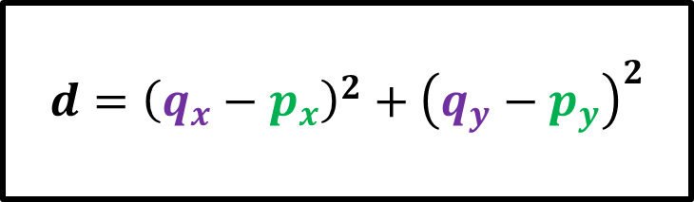
Euclidean Squared Distance
The Euclidean squared distance metric uses the same equation as the Euclidean distance but does not take the square root
$$q (x,y)$$
$$d={\left(q_{x}−p_{x}\right)}^{2}+{\left(q_{y}−p_{y}\right)}^{2}$$
$$d$$
$$p (x,y)$$

Slide 38

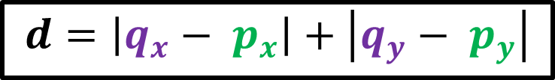


Manhattan Distance
The Manhattan distance is the sum of the horizontal and vertical components or the distance between two points measured along the axes at right angles.
$$q (x,y)$$
$$d=\left|q_{x}− p_{x}\right|+\left|q_{y}− p_{y}\right|$$
$$d$$
$$p (x,y)$$

Slide 39





Manhattan Distance
The Manhattan distance is the sum of the horizontal and vertical components or the distance between two points measured along the axes at right angles.
$$q (1,5)$$
$$d=\left|q_{x}− p_{x}\right|+\left|q_{y}− p_{y}\right|$$
$$p (5,1)$$
$$d=\left|1−5\right|+\left|5−1\right|$$
$$d$$
$$d=4+4$$
$$d=8$$

Slide 40



Cosine Distance
The cosine distance similarity measures the angle between two vectors.
$$d=\frac{\sum_{i=1}^{n}{ q_{i}p_{i}}}{\sqrt{\sum_{i=1}^{n}{ {q_{i}}^{2} }}\sqrt{\sum_{i=1}^{n}{ {p_{i}}^{2} }}}$$
$$q (x,y)$$
$$p (x,y)$$

Slide 41
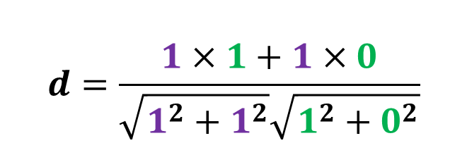



Cosine Distance
The cosine distance similarity measures the angle between two vectors.
$$d=\frac{\sum_{i=1}^{n}{ q_{i}p_{i}}}{\sqrt{\sum_{i=1}^{n}{ {q_{i}}^{2} }}\sqrt{\sum_{i=1}^{n}{ {p_{i}}^{2} }}}$$
$$q (1,1)$$
$$d=\frac{1×1+1×0}{\sqrt{1^{2}+1^{2}}\sqrt{1^{2}+0^{2}}}$$
$$p (0,1)$$
$$d=0.71$$

